Slide 1

A Gentle Introduction to Graph Theory
Presented by:
Elizer Ponio Jr.
Department of Computer Science
College of Computing and Information Technologies

Slide 2
Outline
Introduction to Graph Theory
Graph Representation
Types of Graphs
Applications of Graphs

Slide 3
Graph Theory
Computer science loves to borrow stuff. More specifically, it has borrowed a lot of concepts from logic and mathematics.
As it turns out, this is the case with graphs.
Graph data structures as we know them to be computer science actually came from math, and the study of graphs, which is referred to as graph theory.

Slide 4
Graph Theory
In mathematics, graphs are a way to formally represent a network, which is basically just a collection of objects that are all interconnected.

Slide 5
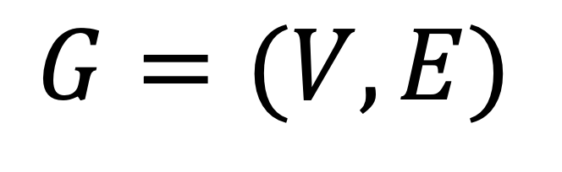
Formal Definition of a Graph
A graph (G) is a pair of vertices (V) and a set of edges (E),
$$G=(V,E)$$
Formal mathematical notation for defining graphs!

Slide 6
Components of a Graph
There are two main parts of a graph:
The vertices or nodes where the data is stored
The edges or connections which connect the nodes

Slide 7
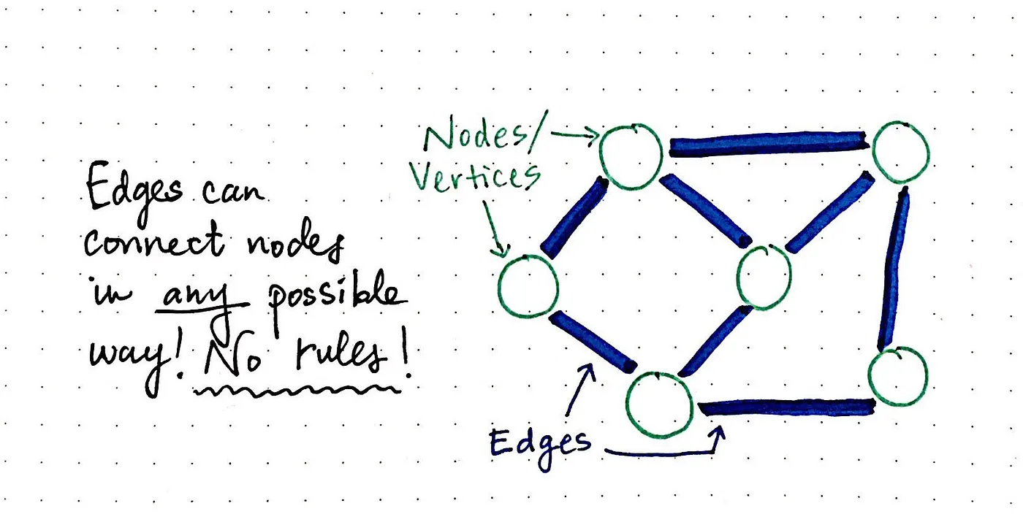
Components of a Graph

Slide 8
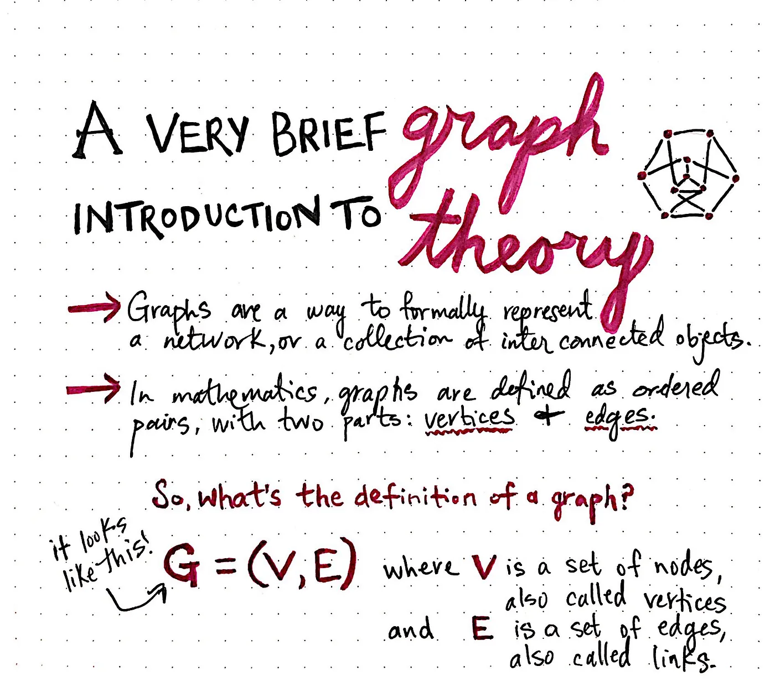

Slide 9

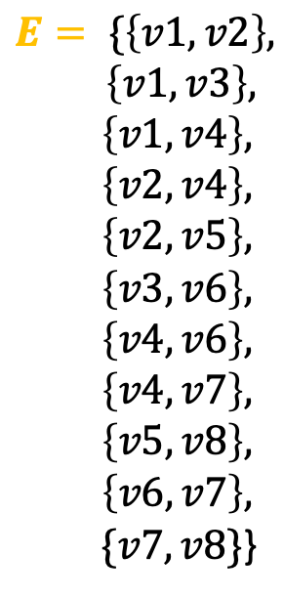

V1
V2
$$G=(V,E)$$
V3
V4
V5
$$V=\{v1, v2,v3,v4,v5,v6,v7,v8\}$$
$$E= \{\left\{v1, v2\right\},$$
$\left\{v1,v3\right\},$
$\left\{v1,v4\right\},$
$\left\{v2,v4\right\},$
$\left\{v2,v5\right\},$
$\left\{v3,v6\right\},$
$\left\{v4,v6\right\},$
$\left\{v4,v7\right\},$
$\left\{v5,v8\right\},$
$\left\{v6,v7\right\},$
$\{v7,v8\}$}
V6
V7
V8
8 vertices/nodes
11 edges

Slide 10
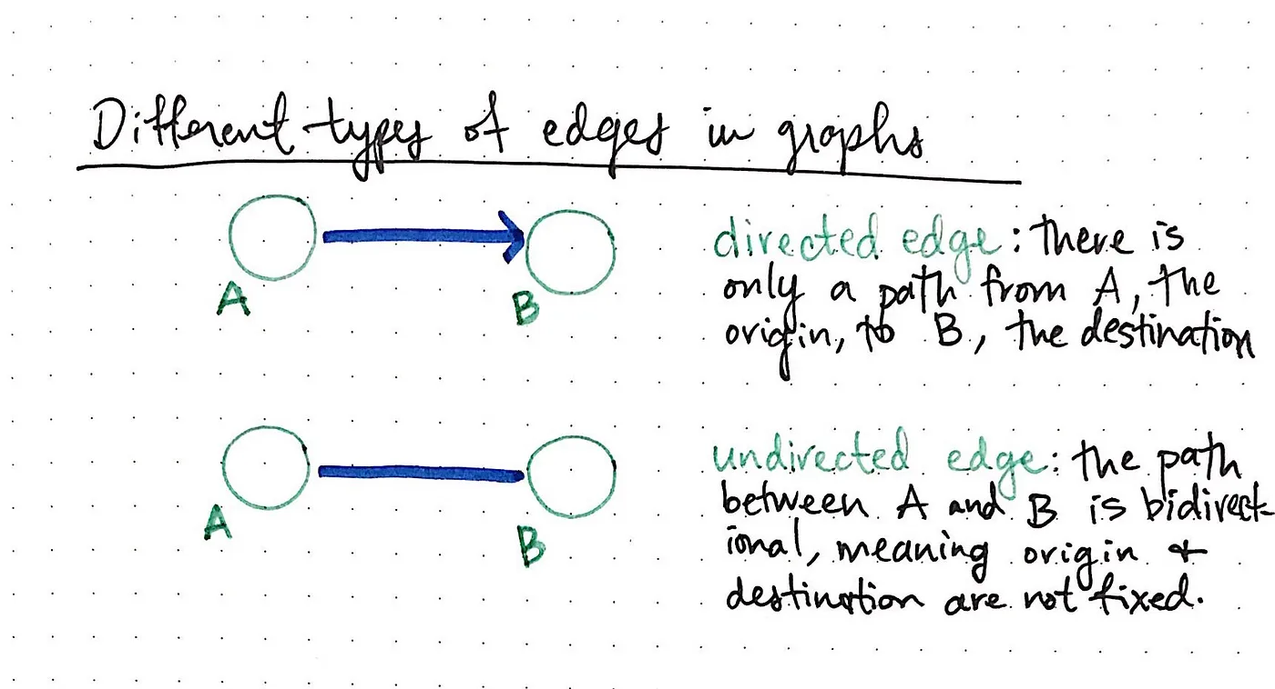

Slide 11
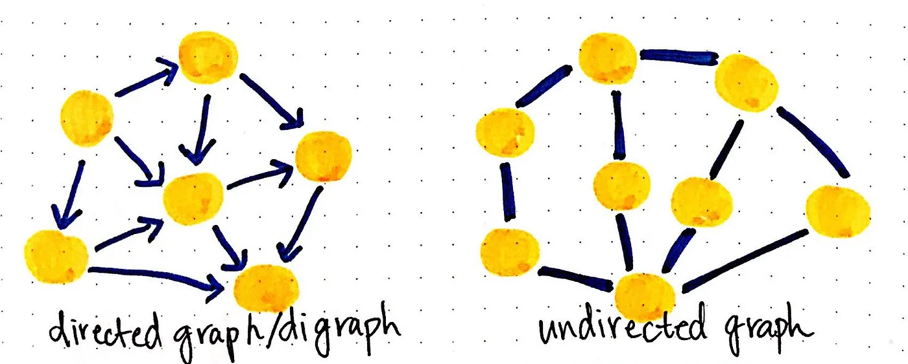

Slide 12
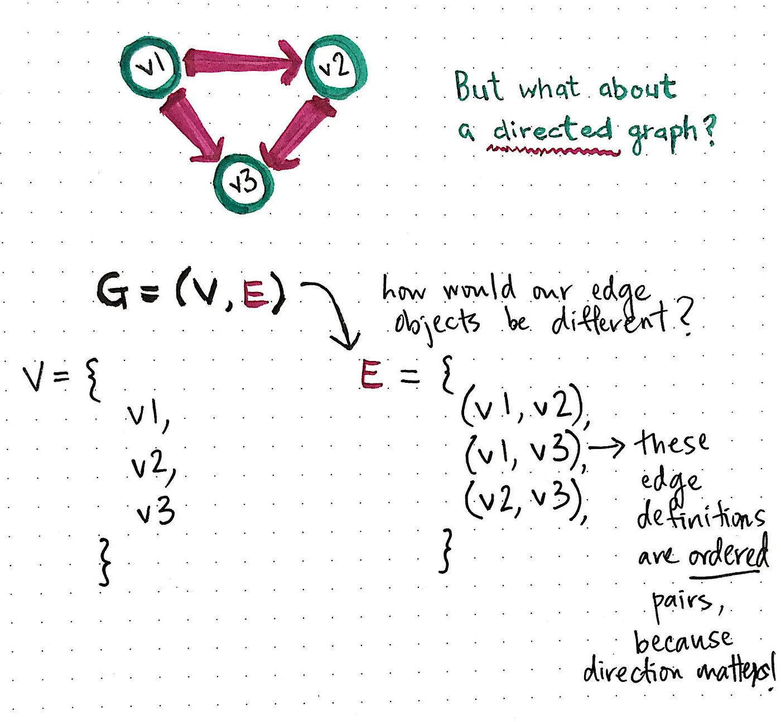

Slide 13
Terminologies
Adjacency
Path

Slide 14
Adjacency
A vertex is said to be adjacent to another vertex if there is an edge connecting them.

Slide 15




Adjacency
v1
v2
V1 is adjacent to V2, V3 and V4.
V3 is not adjacent to V2.
v3
v4

Slide 16
Path
A sequence of edges that allows you to go from vertex A to vertex B is called a path.

Slide 17
Path
V1
V2
Path from V4 to V2:
1. V4 to V1.
2. V1 to V2.
V3
V4

Slide 18
Outline
Introduction to Graph Theory
Graph Representation
Types of Graphs
Applications of Graphs

Slide 19
Graph Representation
Adjacency Matrix
Adjacency List

Slide 20
Adjacency Matrix
a two-dimensional array of V x V vertices. Each row and column represent a vertex.
a way of representing a graph as a matrix of Boolean (0’s and 1’s).

Slide 21
Adjacency Matrix
V1
V2
 |  | Nica | Jonnah | Ronn
 | 0 | 1 | 1 | 1
 | 1 | 0 | 1 | 0
 | 1 | 1 | 0 | 0
 | 1 | 0 | 0 | 0
V3
V4

Slide 22
Adjacency List
An adjacency list represents a graph as an array of linked lists.
The index of the array represents a vertex and each element in its linked list represents the other vertices that form an edge with the vertex.

Slide 23
Adjacency Matrix
V1
V2
V3
V4

Slide 24
Outline
Introduction to Graph Theory
Graph Representation
Types of Graphs
Applications of Graphs

Slide 25

Directed Graph
A graph in which edge has a direction.

Slide 26

Undirected Graph
A graph in which edge does not have any direction.

Slide 27
Connected Graph
A graph where every node can be visited from other nodes.

Slide 28
Disconnected Graph
A graph in which at least one node is not reachable from a node.

Slide 29
Complete Graph
A graph in which each node has edges to all other nodes

Slide 30
Weighted Graph
In a weighted graph, each edge is assigned with some value such as length or weight. The weight of an edge e must be a positive (+) value indicating the cost of traversing the edge.
10
5
3
8

Slide 31
Outline
Introduction to Graph Theory
Graph Representation
Types of Graphs
Applications of Graphs

Slide 32
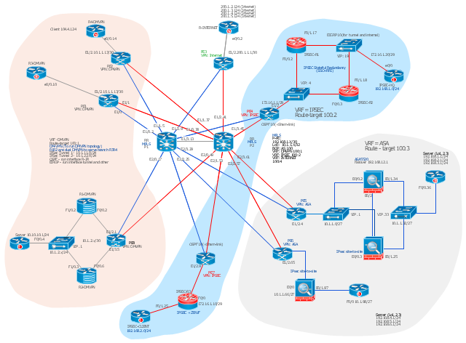
Network architecture and operations

Slide 33
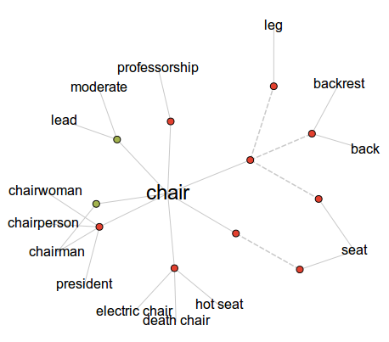
Word nets

Slide 34
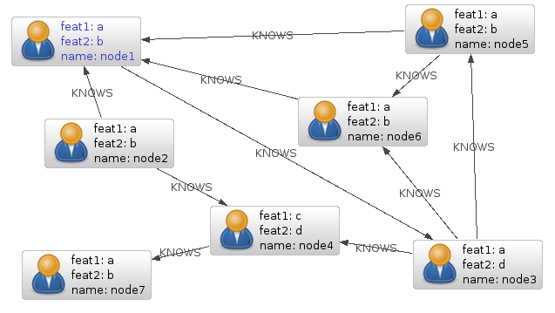
Relationships of database entities

Slide 35
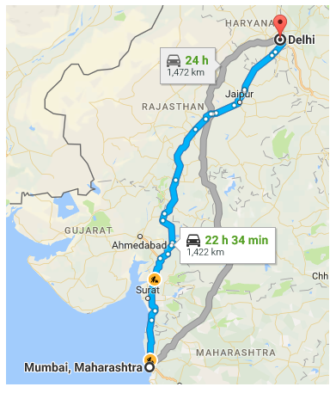
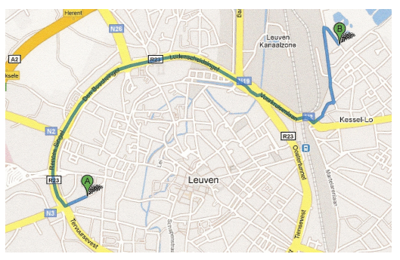
Navigation Systems

